Slide 1
2.26.2020
Magenic Masters Live – Intro To Machine Learning
Kevin Ford
kevinf@magenic.com
617 359-5192

Slide 2
https://github.com/Magenic/MMLIntroToML

Slide 3











Starting with Azure Cognitive Services
Canned models that do specific things
Some can be trained
Some can work client side
Notes:
Computer Vision
Speech
Text Analysis
Face
Translate Text
Custom Vision
Content Moderator
Speaker Recognition
Ink recognizer
Speech
QnA Maker
Anomaly Detector

Slide 4
Natural Language Understanding (LUIS)

Slide 5
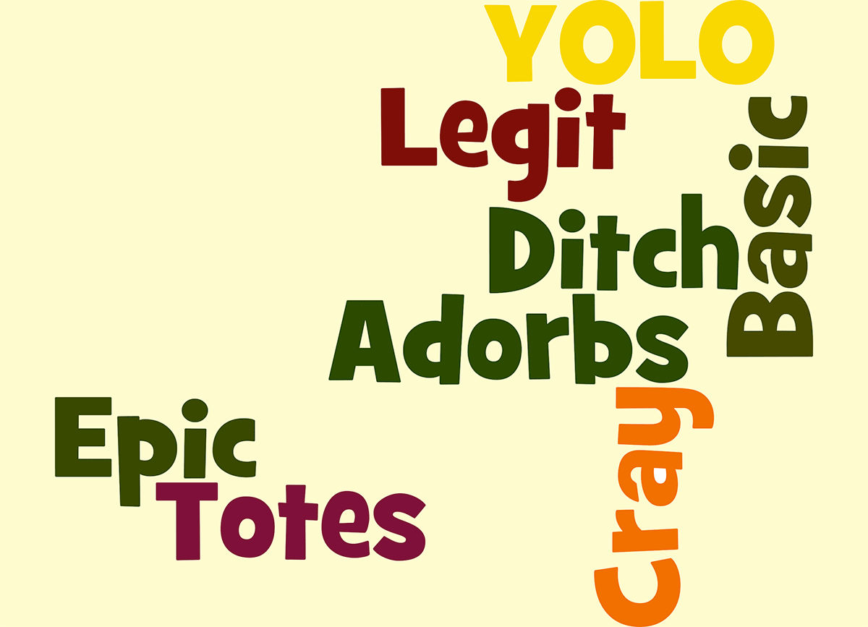
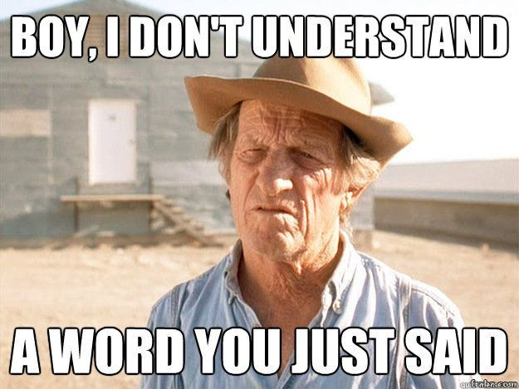
When to use language understanding?
Not a guided process but perhaps a selector for what they want to do
Simple interactions that can be expressed in multiple ways – Complex interactions? Use a Bot
When the same types of actions need to happen to different things
When interacting with a traditional data entry screen isn’t optimal
When you understand how your audience communicates

Slide 6

Simple Model Using Azure Luis
User entered text
Evaluation of entered text
Application Logic

Slide 7

Key Concepts
Entity
Intent
Utterance
Descriptor
Pattern
App -> Model
Notes:
Entity – a list of replaceable elements that tell you something about what is being asked for
Intent – the type of interaction the user wants I want a new project, gives a list of examples
Utterance – input from the user that the app will interpret
Descriptor – A thing that is all the same, like a list of cities
Pattern – Template utterances instead of by example
App – A collection of entities, intents and other items used to create a domain specific model

Slide 8
LUIS Model Development
https://www.luis.ai/applications
Feature Extraction
Classification
Prediction
Plan
Setup Intents and Entities
Train
Test
Publish
Prebuilt Domains
Model

Slide 9
Demo – Luis
Intents:
Get characteristic and species of pet
What is the X of your Y?
What do you want to do to pet?
I want to X your Y
Entities:
Characteristics
name
color
breed
Species
Cat
Dog
Possum
Action
pet
feed
walk
Training Portal: https://preview.luis.ai/)

Slide 10
Azure Faces
Detect a face in an image
Find similar faces from a list
Group similar faces
Identify a face
Verify two faces are the same

Slide 11
Ways to store face information
 | Max items | Max number of lists | Max faces per entry
Face List | 1,000 | 64 | 1
Large Face List | 1,000,000 | 64 64 (f0), 1,000,000 (s0) | 1
Person Group | 1,000 (f0) 10,000 (s0) | 1,000 (f0) 1,000,000 (s0) | 248
Large Person Group | 1,000,000 | 1,000 (f0) 1,000,000 (s0) | 248

Slide 12
Face Verification Lifecycle
Add people
Train model
Identify Face
Create Person Collection
Add person To collection
Add pictures
Get face from image
Get face from image
Add face to person
Verify same person

Slide 13
Face Detection Models
recognition_01
recognition_02

Slide 14
Demo – Azure Faces
Rocky Links
https://c1.staticflickr.com/9/8406/8695972129_6276416fea_b.jpg
https://i.ytimg.com/vi/-s_CoeLwRtY/maxresdefault.jpg
http://www.prairiedevcon.com/images/site/RockyKeynote.png
Test Images
Rocky http://vslive.com/events/vslive-fall-2010/~/media/ECG/VSLive/Redmond/Speakers120/Lhotka_Rocky120.ashx
Kevin https://live.staticflickr.com/8537/8696311703_ba2c7eaf17_b.jpg Penn https://3.bp.blogspot.com/-n3CtwdhaYJY/WP5RkY6bE3I/AAAAAAAAXBo/MKH_wyjemmU_QLS7eamhmCiQYoMSsziFwCLcB/s1600/Penn_Jilette.jpg

Slide 15
QnA Maker
It’s a bot!
Creates a knowledge base
Imports questions and answers
Potentially zero code solution

Slide 16
When do I use QnA Maker?
Static Information
Always the same answer
OK with static meta information (chit-chat)
Provide a static flow

Slide 17
Demo – Using QnA maker
https://www.qnamaker.ai/

Slide 18
Anomaly Detector (Preview)
Finds anomalies given data in a time series
Uses a Spectral Residual
Three different things to use it for
Is the latest point in a series an anomaly? (Real time monitoring)
Evaluate all points, check if all points in a range (Historical analysis)
Does a specific point signify a change? (REST ) (When did things go awry?)

Slide 19
How does it Work?
Spectral Residual

Slide 20
Anomaly Detector Advantages / Usages
Unsupervised Learning
Takes almost any time/numeric pairs regardless of nature of series
Low time/CPU results
>

Slide 21
Demo – Using Anomaly Detector

Slide 22
Homework Readings
Readings:
https://docs.microsoft.com/en-us/azure/cognitive-services/luis/what-is-luis
https://docs.microsoft.com/en-us/azure/cognitive-services/luis/luis-get-started-create-app
https://docs.microsoft.com/en-us/azure/cognitive-services/luis/get-started-portal-build-app
https://docs.microsoft.com/en-us/azure/cognitive-services/luis/get-started-portal-deploy-app
Homework
Create and deploy a sample Luis endpoint to understand the intent of the speaker and pull out relevant entities
Give me endpoint and api key and what type of intents your LUIS portal can understand

Slide 23
Q & A

